Slide 1

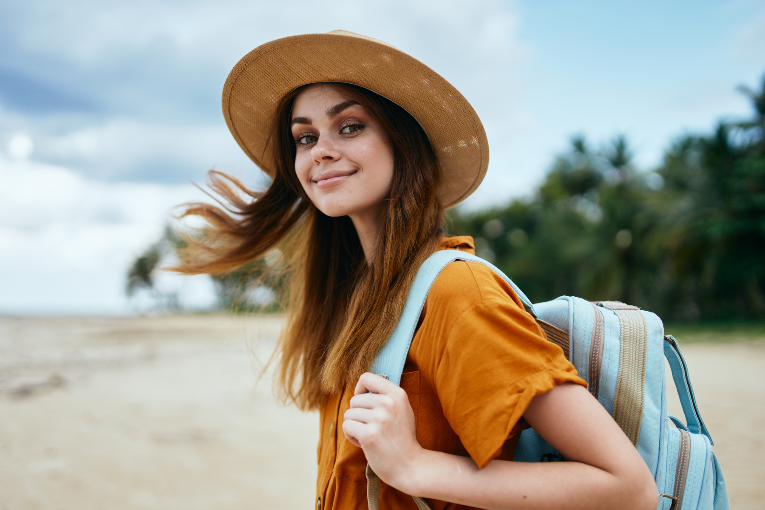




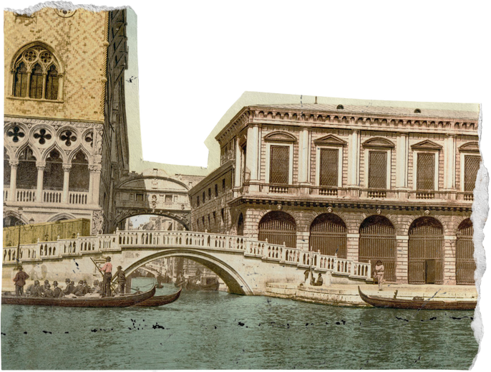

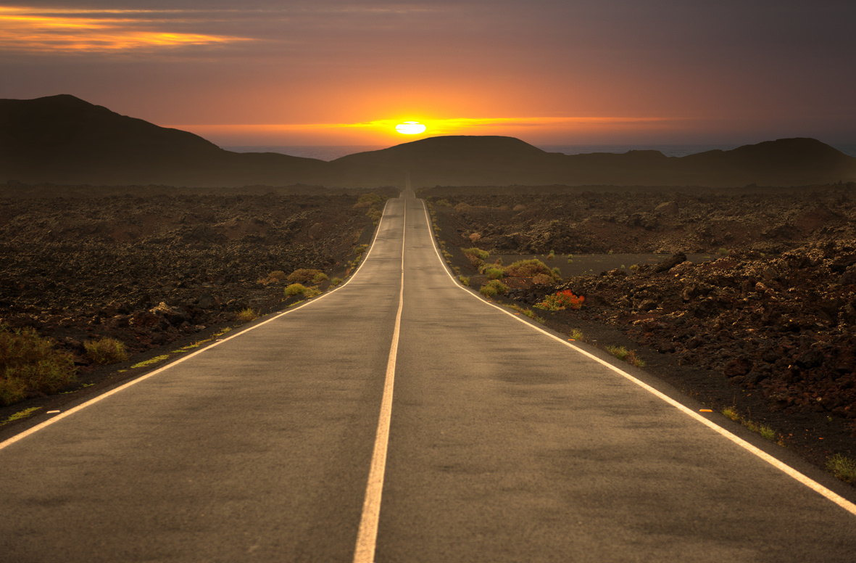
Home
Photo
About Us
Contact
Building a Dynamic Traveller Community
The Return Journey

Slide 2

Proposed Solutions
User Profiles
Showcase: Highlight user experiences.
Travel Groups:
Connect: Network with like-minded travelers.
01
05
Interactive Travel Feed:
Engage: Involve users with dynamic content.
02
Destination Pages:
Explore: Discover new places and insights.
Events and Meetups:
Socialize: Foster community interaction.
03
07
Trip Planning Tools:
Organize: Arrange itineraries seamlessly.
04

Slide 3

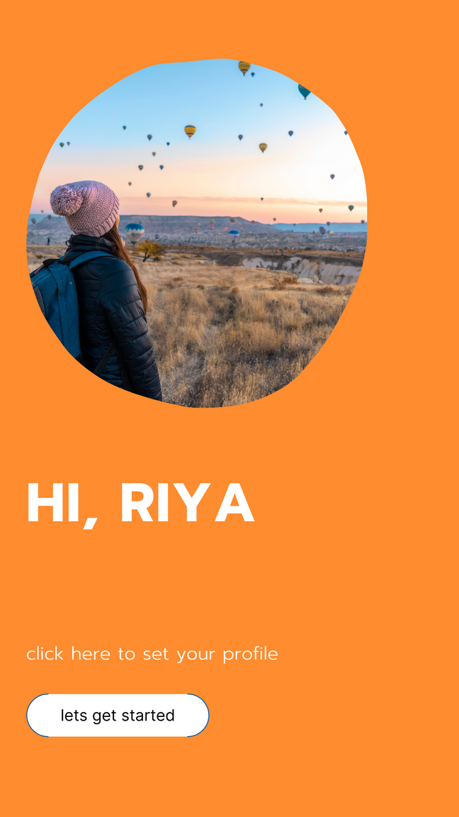
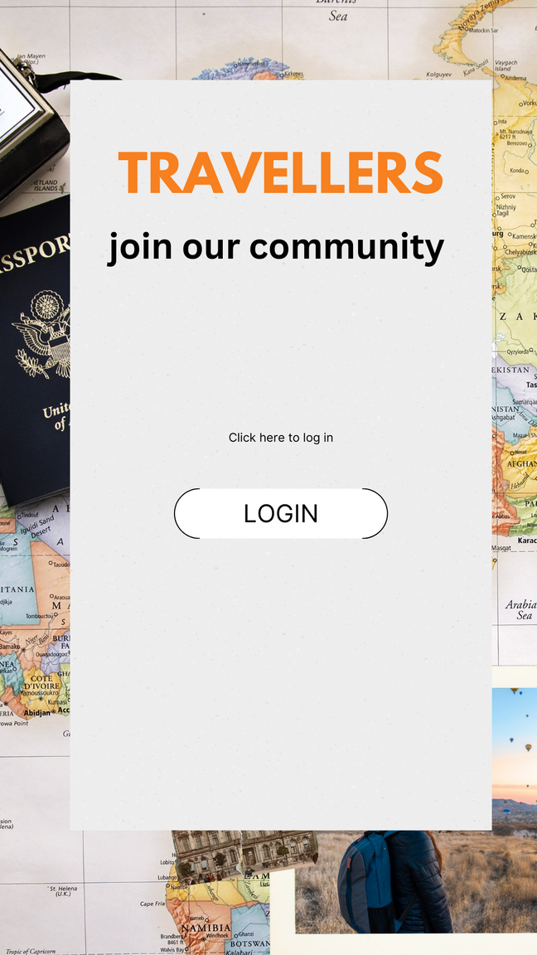
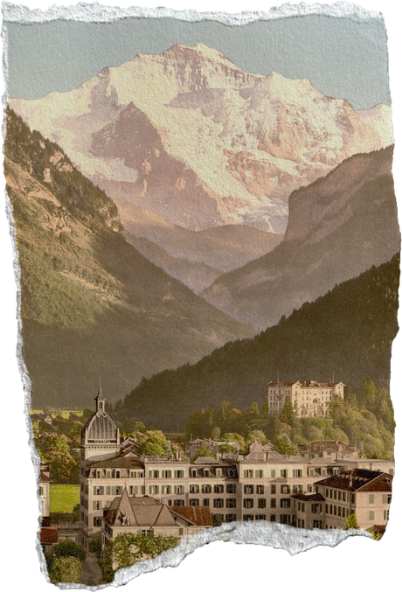

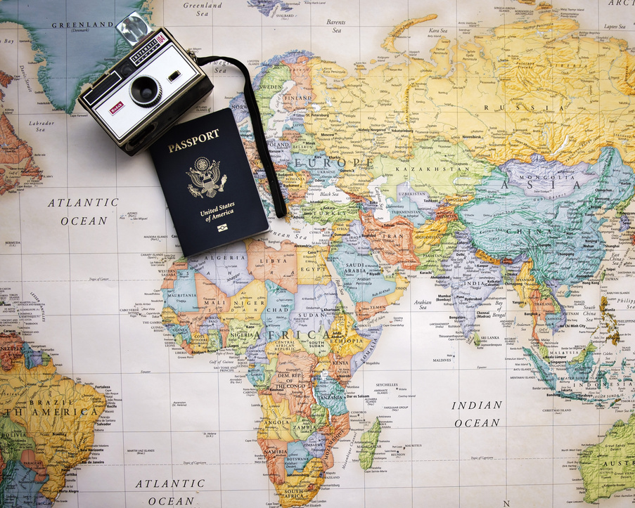

User Profiles: Sharing Your Travel Story
Personalization: Customize your profile with photos, bio, and travel preferences.
Travel Highlights: Showcase your favorite destinations, memorable experiences, and travel milestones.
Connections: Connect with fellow travelers, follow friends, and discover new travel buddies .
Kickstart community engagement with profiles for future connections and newsletter subscriptions, fostering a dynamic travel community

Slide 4

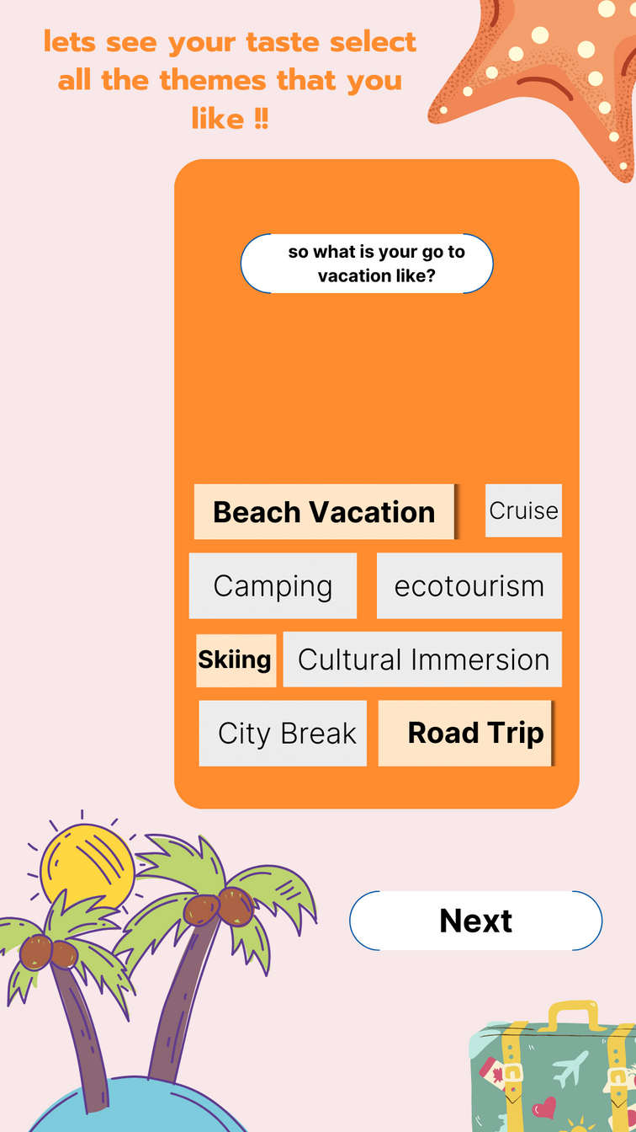
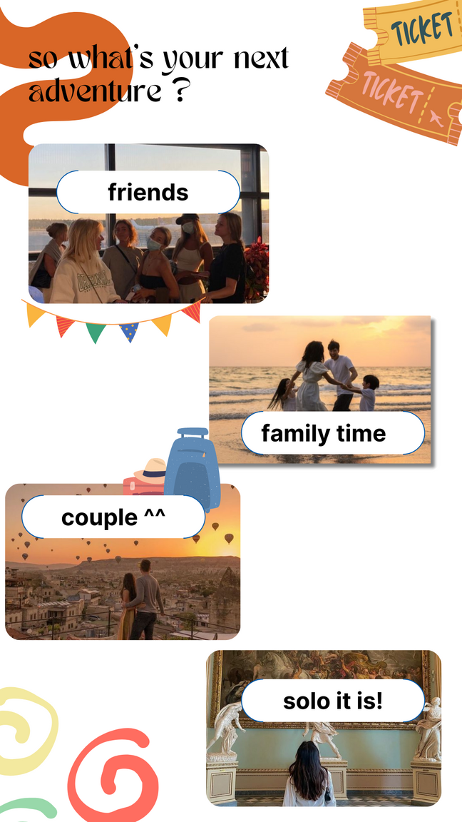
Personalized Preferences: Tailoring Your Travel Experience
Theme Preferences: Choose from adventure, culture, relaxation, and more.
Budget Settings: Set your budget for accommodations, activities, and dining.
Location Preferences: Specify preferred destinations or regions for your travels.
Activity Preferences: Indicate your interests, whether it's hiking, culinary experiences, or historical tours .
"Tailored Profile & Destination Search"
"Customize your profile with preferences such as destinations, terrain, past travels, festivals, and budget. Explore destinations by region, interest, or travel style. Get personalized trip recommendations based on your profile."

Slide 5
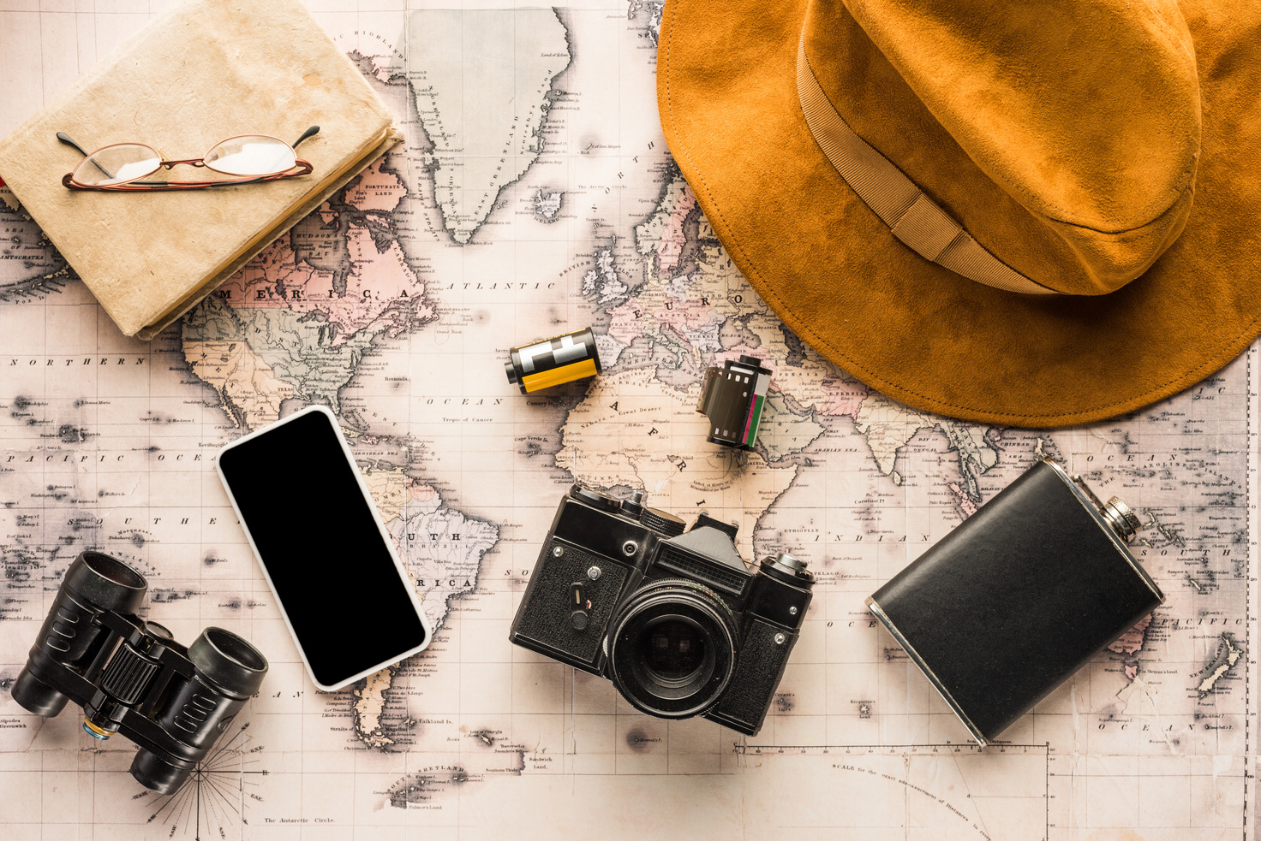
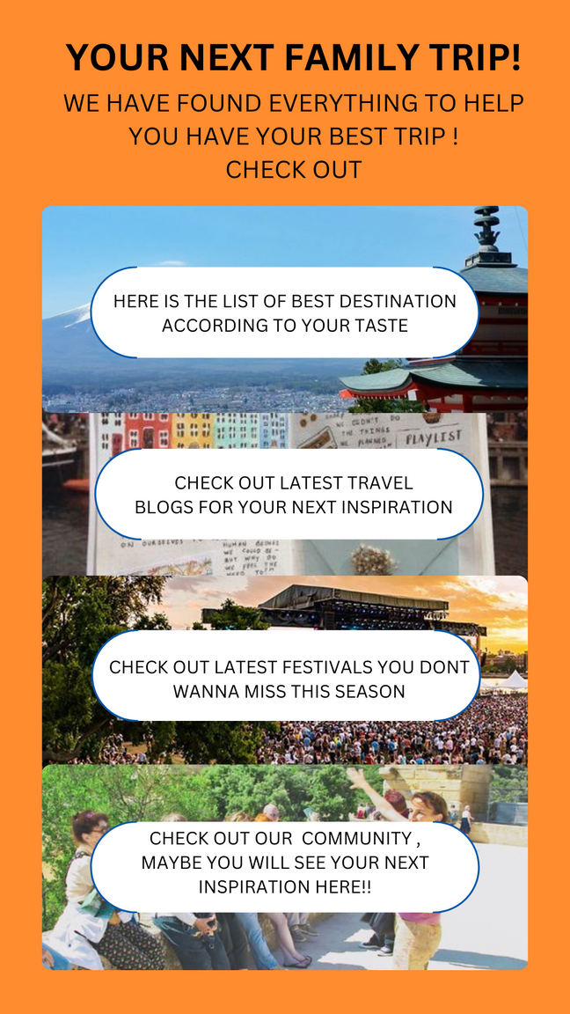
Group Interactions: Connect with Like-Minded Travelers
Explore Your Travel Community: Enhance Your Journey Together
1. **Destination Discovery**: Find tailored travel destinations with real-time popularity insights and convenient filtering options.
2. **Inspiring Blogs**: Access categorized traveler-generated content, interact with bloggers, and contribute to the community's knowledge base.
3. **Festival Fever**: Stay updated on global festivals and events for unique cultural experiences.
4. Interactive Forums: Engage in themed community forums to share stories, ask questions, and gain insights.

Slide 6
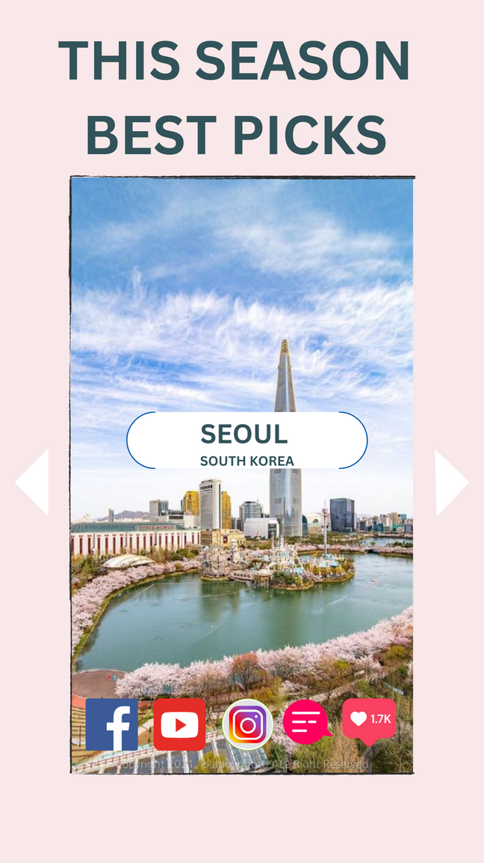
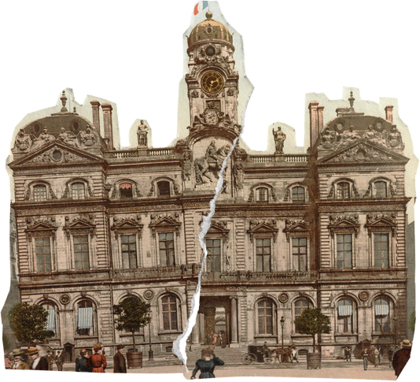
Destination Discussions: Dive Into Travel Conversations
Explore Destinations : Dive deep into discussions about popular and off-the-beaten-path locations.
Share Tips: Exchange insider tips, recommendations, and hidden gems with fellow travelers.
Ask Questions: Seek advice, guidance, and local insights for upcoming trips.
Inspire Others: Share your own travel stories, experiences, and itineraries to inspire fellow adventurers.
Community Feedback: Rate and review destinations, accommodations, and attractions to help others plan their journeys.

Slide 7
Home
Photo
About Us
Contact
"Connect Instagram reels through API to share travel highlights from influencers and users. Engage community members by enabling them to post their vacation experiences. Enhance user interaction with a 'like' button, allowing content to be added to their app wishlist for future reference."

Slide 8
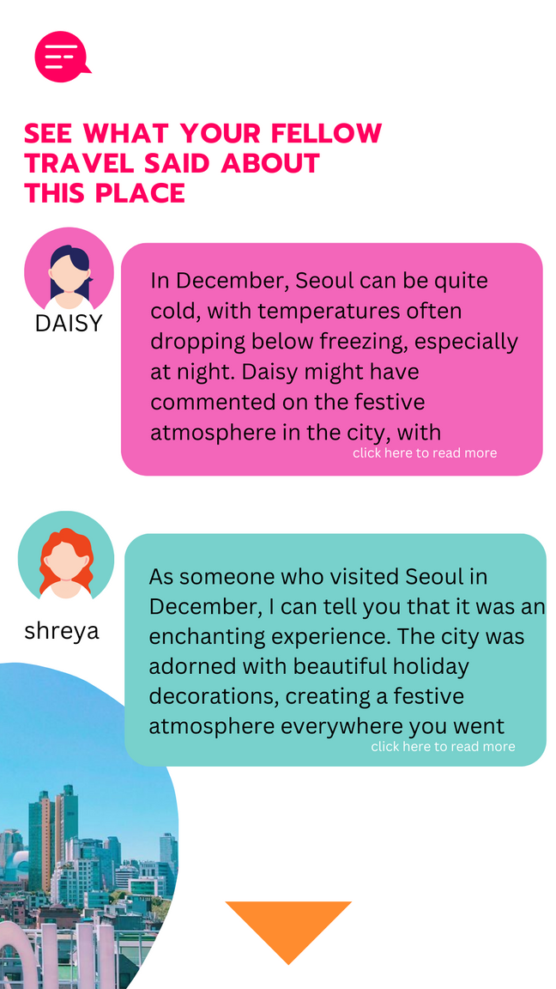
Events Calendar: Stay Connected and Engaged
Virtual and Physical Events: Explore a calendar of travel-related events, workshops, and meetups.
Global Community: Connect with travelers from around the world through virtual gatherings.
Local Meetups: Attend in-person meetups and events organized by community members in your area.
Educational Workshops: Participate in workshops and seminars covering various aspects of travel, culture, and adventure.
Networking Opportunities: Expand your network, meet new friends, and share experiences with like-minded individuals.

Slide 9
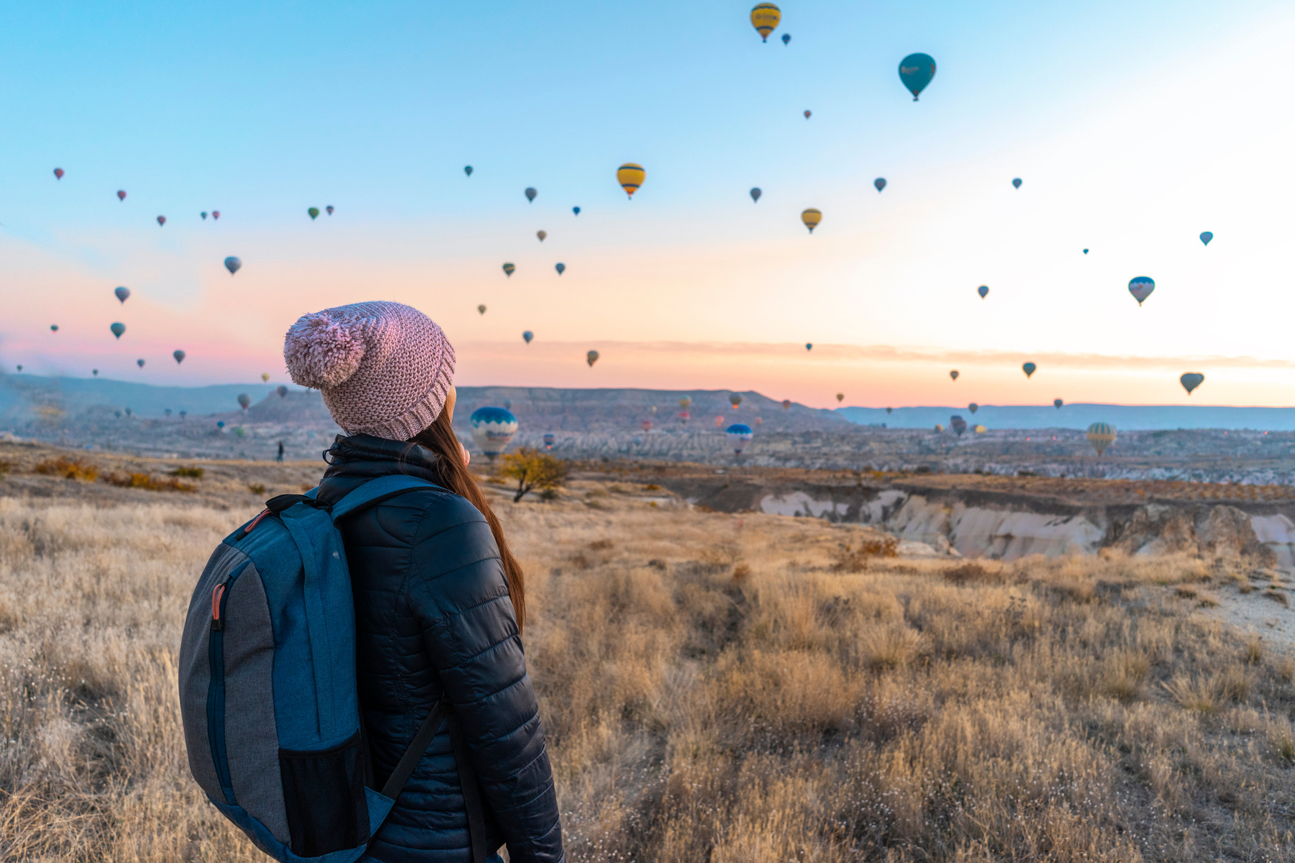
Bailey Dupont
Community Page: Connection and Engagement Hub
Purpose: Connect travelers, share experiences, foster belonging.
Key Features:
User Profiles: Showcasing travel experiences and preferences.
Interactive Feed: Real-time updates, photos, and videos.
Destination Discussions: Conversations about favorite spots.
Group Interactions: Join interest-based groups, plan trips.
Events Calendar: Virtual and physical events, workshops.
Benefits:
Connection: Forge global friendships.
Inspiration: Motivate future travel experiences.
Knowledge Sharing: Exchange valuable insights.

Slide 10

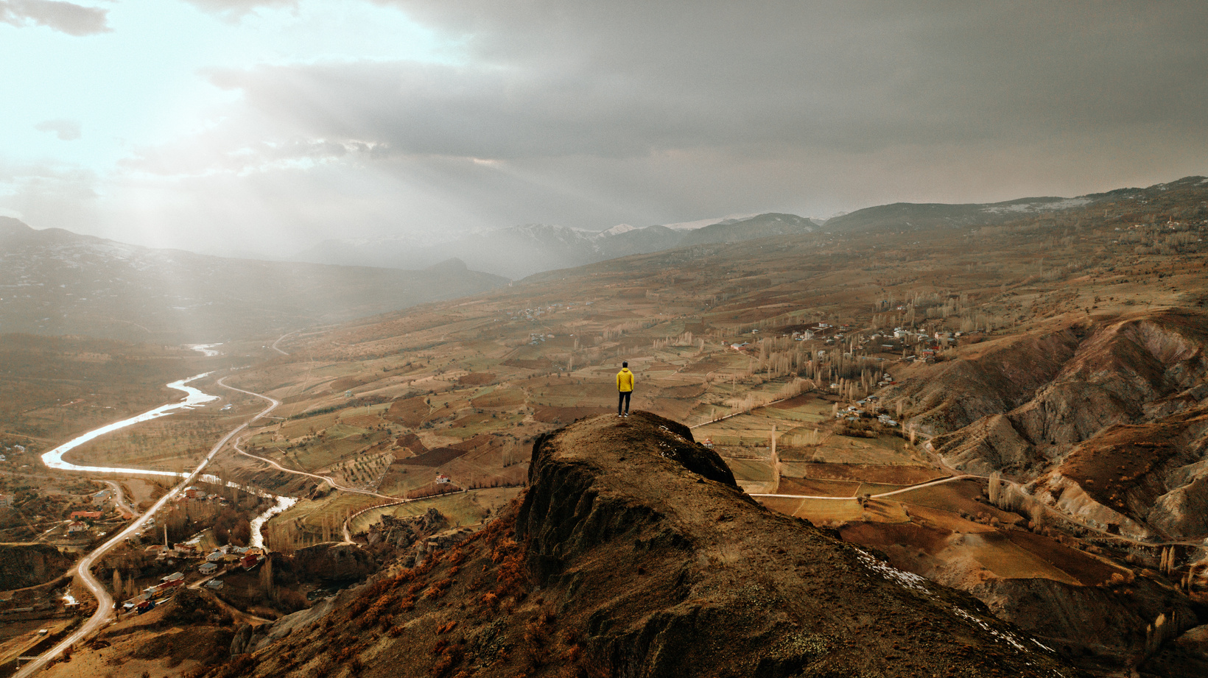
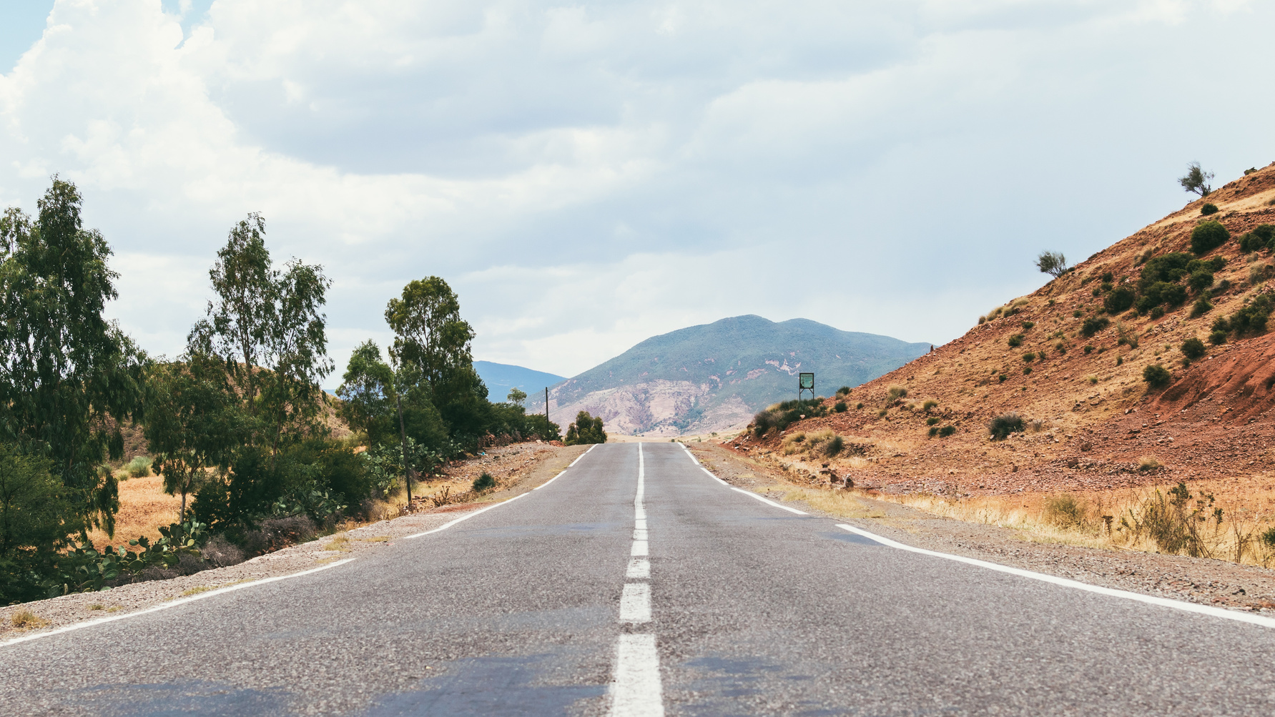

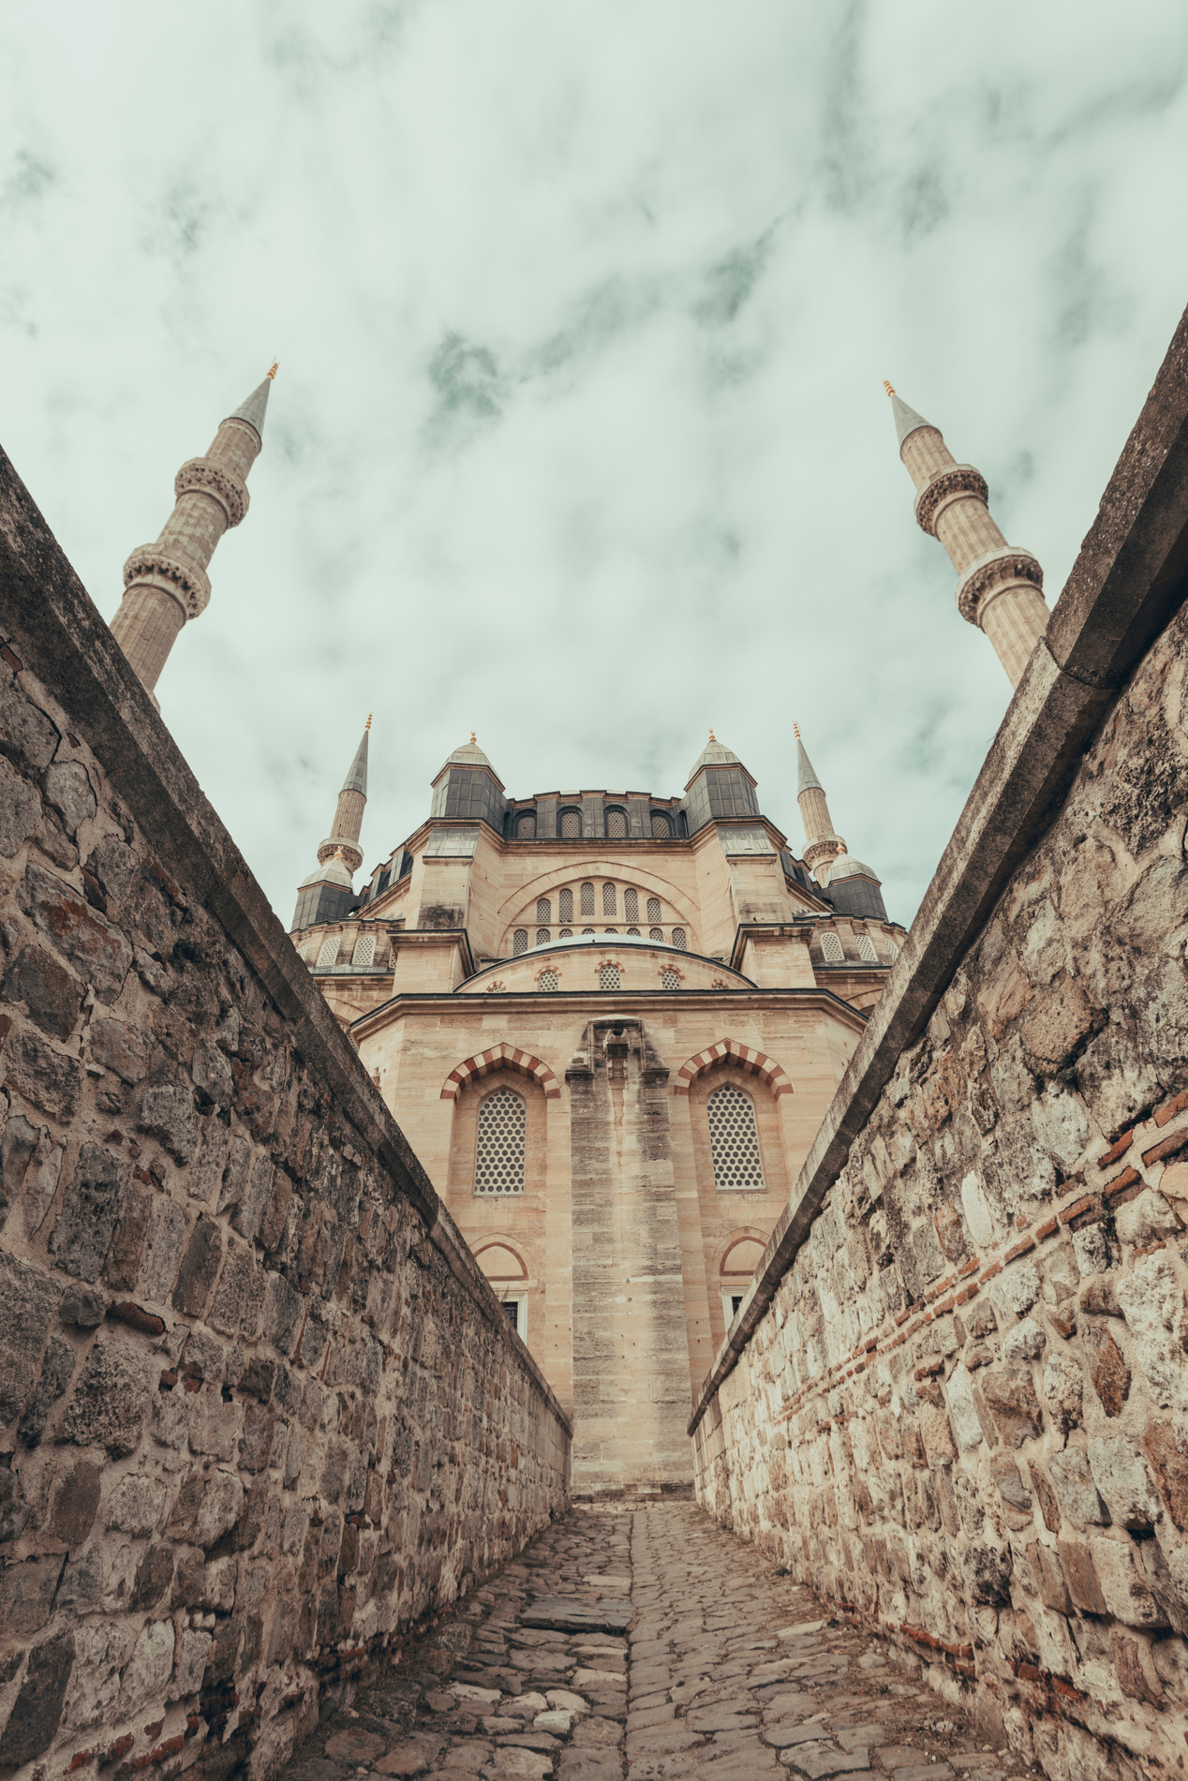
Home
Photo
About Us
Contact
Thank You

